Slide 1

Unit-2
Embedded System and Internet of Things (ESIOT)
Microcontrollers and Programming
B.E.-CSE 3rd Sem.
Department of Interdisciplinary Courses in Engineering (DICE)

Slide 2
Introduction
A microcontroller is a small computer integrated onto a single chip.
It combines one or more CPUs (processor cores) with memory and programmable input/output peripherals.
Microcontrollers have contributed exponentially in the development of many computer applications, industrial instrumentation and controls.
The whole CPU of a computer gets fabricated on a single chip using LSI and VLSI technology with the advancement of semiconductor technology.
Notes:
These processing systems are integrated with components dedicated to handling electric and/or mechanical interfacing.

Slide 3
Features of microcontrollers
On-chip peripherals
Many microcontrollers have a variety of on-chip peripherals, such as timers, serial ports, and analog-to-digital converters, which allow them to interface with external devices.
Memory
Microcontrollers have both program memory, which stores the instructions that are executed by the processor, and data memory, which is used to store variables and other data.
Input/output (I/O) pins
Microcontrollers have a set of I/O pins that can be used to interface with external devices, such as sensors or actuators.
Low power consumption
Microcontrollers are designed to be low-power, which makes them suitable for use in battery-powered devices.
Cost
Microcontrollers are typically less expensive than general-purpose processors, as they are designed for specific tasks and do not have as many capabilities
Size
Microcontrollers are small, which makes them suitable for use in compact devices.
Flexibility
Microcontrollers are highly flexible and can be programmed to perform a wide range of tasks.
Notes:
. A sensor stores the measured quantity to the memory.

Slide 4
Basic components of microcontrollers
Basic components of Microcontroller includes:
CPU: Executes instructions and performs calculations.
Memory: Stores program and data.
I/O Ports: Interface with other devices.
Timers/Counters: Measure time intervals or count events.
Communication Interfaces: Connect to other systems (e.g., UART, SPI, I2C).
Notes:
. A sensor stores the measured quantity to the memory.

Slide 5
Microprocessor
A microprocessor is a processor that is contained on a microchip, or integrated circuit (IC). It is a central processing unit (CPU) that executes the instructions of a computer program. Some features of microprocessors include:
Instruction set: Microprocessors have a specific instruction set that defines the operations that they can perform.
Clock speed: The clock speed of a microprocessor determines how fast it can execute instructions. Microprocessors typically have high clock speeds, which allows them to perform tasks quickly.
Data bus: The data bus is a communication pathway that is used to transfer data between the microprocessor and other components in a system.
Address bus: The address bus is a communication pathway that is used to transfer the address of a memory location between the microprocessor and other components in a system.
Cache: Many microprocessors have one or more levels of cache, which is a small amount of high-speed memory that is used to store frequently accessed data. This helps to improve the performance of the microprocessor.
Notes:
. A sensor stores the measured quantity to the memory.

Slide 6
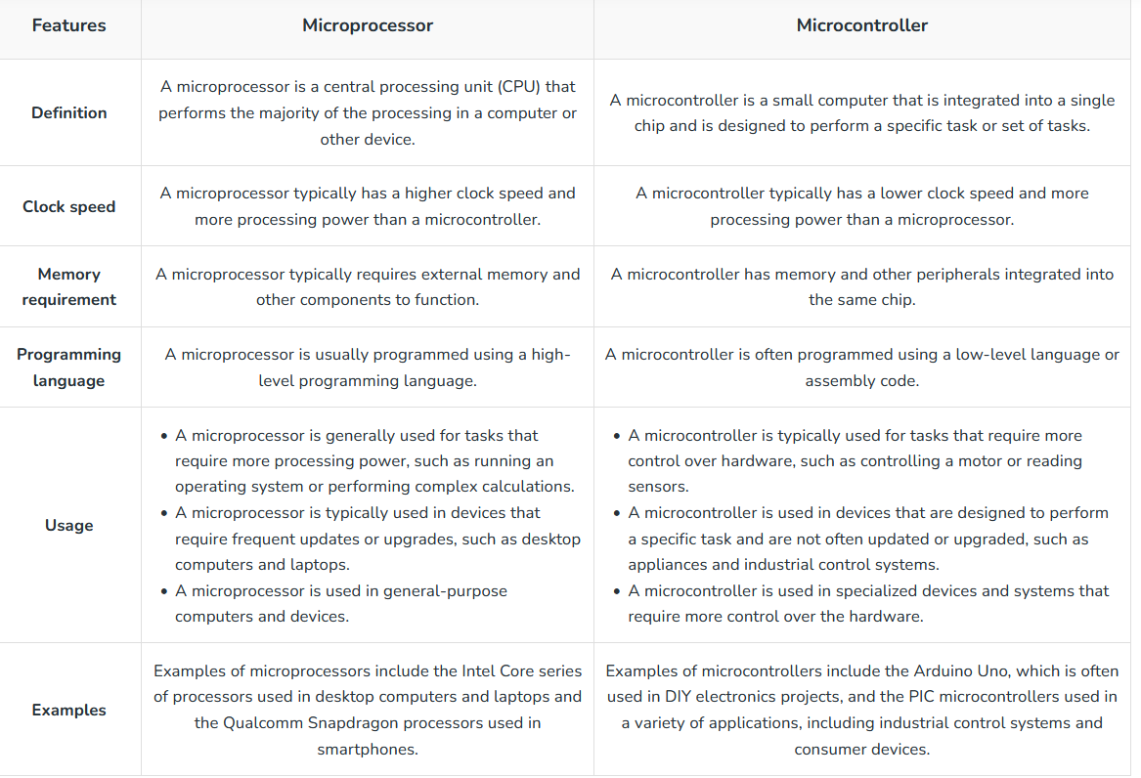
Microprocessor vs Microcontroller
Notes:
. A sensor stores the measured quantity to the memory.

Slide 7
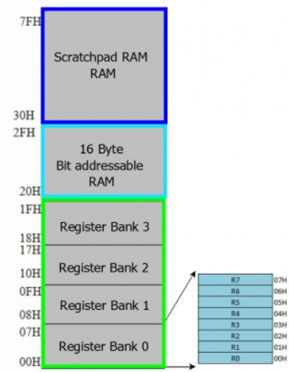
Types of Embedded system
The 8051 microcontroller's memory is divided into Program Memory and Data Memory.
Program Memory (ROM) is used for permanent saving program being executed, while Data Memory (RAM) is used for temporarily storing and keeping intermediate results and variables.
Up to 256 bytes of internal data memory is available.
Locations available to the user occupy addressing space from 0 to 7Fh.
The first 128 bytes of internal data memory are both directly and indirectly addressable and the upper 128 bytes of data memory (80-FFH) can be addressed only indirectly.
8051 can use up to 64K Bytes of external data memory with EA=0.
Notes:
microcontroller performance, embedded systems are divided into small-scale, medium-scale, and sophisticated categories, depending on the bit size of the microcontroller.

Slide 8
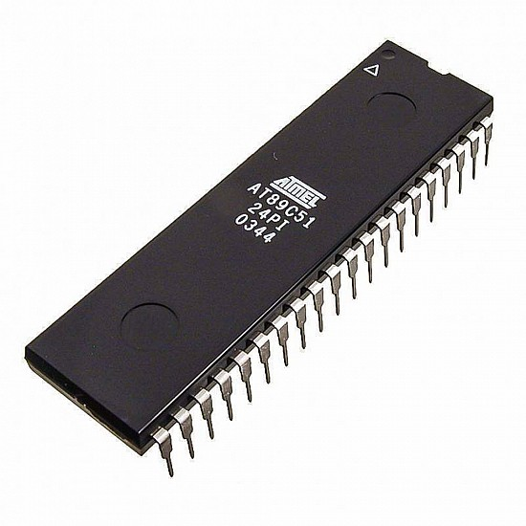
Pin diagram of 8051 Microcontroller
The 8051 microcontroller is a popular 8-bit microcontroller widely used in embedded systems. It is a single-chip microcontroller with a Harvard architecture that includes a CPU, RAM, ROM, and several peripherals.
The 8051 microcontroller has a 40-pin dual in-line package (DIP) that provides various inputs and outputs for communication with external devices.
These 40 pins serve different functions like read, write, I/O operations, interrupts etc.
8051 has four I/O ports wherein each port has 8 pins which can be configured as input or output depending upon the logic state of the pins

Slide 9
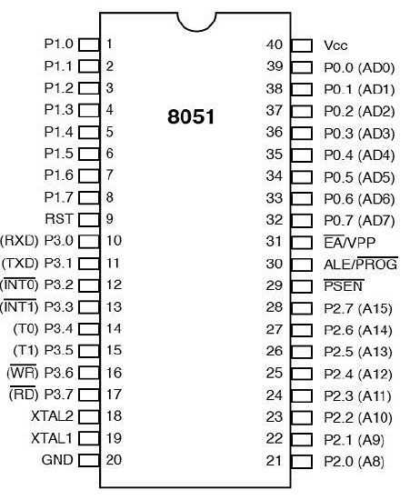
8051 Pin configuration

Slide 10
Description of Pins
Pin 1 to Pin 8 (Port 1) – Pin 1 to Pin 8 are assigned to Port 1 for simple I/O operations. They can be configured as input or output pins depending on the logic control i.e. if logic zero (0) is applied to the I/O port it will act as an output pin and if logic one (1) is applied the pin will act as an input pin. These pins are also referred to as P1.0 to P1.7 (where P1 indicates that it is a pin in port 1 and the number after ‘.’ tells the pin number i.e. 0 indicates first pin of the port. So, P1.0 means first pin of port 1, P1.1 means second pin of the port 1 and so on). These pins are bidirectional pins.

Slide 11
Description of Pins
Pin 9 (RST) – Reset pin.
It is an active-high, input pin. Therefore if the RST pin is high for a minimum of 2 machine cycles, the microcontroller will reset i.e. it will close and terminate all activities. It is often referred as “power-on-reset” pin because it is used to reset the microcontroller to it’s initial values when power is on (high).

Slide 12
Description of Pins
Pin 10 to Pin 17 (Port 3) – Pin 10 to pin 17 are port 3 pins which are also referred to as P3.0 to P3.7. These pins are similar to port 1 and can be used as universal input or output pins. These pins are bidirectional pins.

Slide 13
Description of Pins
These pins also have some additional functions which are as follows:
P3.0 (RXD) : 10th pin is RXD (serial data receive pin) which is for serial input. Through this input signal microcontroller receives data for serial communication.
P3.1 (TXD) : 11th pin is TXD (serial data transmit pin) which is serial output pin. Through this output signal microcontroller transmits data for serial communication.
P3.2 and P3.3 (INT0′, INT1′ ) : 12th and 13th pins are for External Hardware Interrupt 0 and Interrupt 1 respectively. When this interrupt is activated(i.e. when it is low), 8051 gets interrupted in whatever it is doing and jumps to the vector value of the interrupt (0003H for INT0 and 0013H for INT1) and starts performing Interrupt Service Routine (ISR) from that vector location.
P3.4 and P3.5 (T0 and T1) : 14th and 15th pin are for Timer 0 and Timer 1 external input. They can be connected with 16 bit timer/counter.
P3.6 (WR’) : 16th pin is for external memory write i.e. writing data to the external memory.
P3.7 (RD’) : 17th pin is for external memory read i.e. reading data from external memory.

Slide 14
Description of Pins
Pin 18 and Pin 19 (XTAL2 And XTAL1) – These pins are connected to an external oscillator which is generally a quartz crystal oscillator. They are used to provide an external clock frequency of 4MHz to 30MHz.
Pin 20 (GND) – This pin is connected to the ground. It has to be provided with 0V power supply. Hence it is connected to the negative terminal of the power supply.
Pin 21 to Pin 28 (Port 2) – Pin 21 to pin 28 are port 2 pins also referred to as P2.0 to P2.7. When additional external memory is interfaced with the 8051 microcontroller, pins of port 2 act as higher-order address bytes. These pins are bidirectional.

Slide 15
Description of Pins
Pin 29 (PSEN) – PSEN stands for Program Store Enable. It is output, active-low pin. This is used to read external memory. In 8031 based system where external ROM holds the program code, this pin is connected to the OE pin of the ROM.
Pin 30 (ALE/ PROG) – ALE stands for Address Latch Enable. It is input, active-high pin. This pin is used to distinguish between memory chips when multiple memory chips are used. It is also used to de-multiplex the multiplexed address and data signals available at port 0. During flash programming i.e. Programming of EPROM, this pin acts as program pulse input (PROG).
Pin 31 (EA/ VPP) – EA stands for External Access input. It is used to enable/disable external memory interfacing. In 8051, EA is connected to Vcc as it comes with on-chip ROM to store programs. For other family members such as 8031 and 8032 in which there is no on-chip ROM, the EA pin is connected to the GND.

Slide 16
Description of Pins
Pin 32 to Pin 39 (Port 0) – Pin 32 to pin 39 are port 0 pins also referred to as P0.0 to P0.7. They are bidirectional input/output pins. They don’t have any internal pull-ups. Hence, 10 K? pull-up registers are used as external pull-ups. Port 0 is also designated as AD0-AD7 because 8051 multiplexes address and data through port 0 to save pins.
Pin 40 (VCC) – This pin provides power supply voltage i.e. +5 Volts to the circuit.

Slide 17
Ports in 8051
Pin configuration, i.e. the pin can be configured as 1 for input and 0 for output as per the logic state.
Input/Output (I/O) pin − All the circuits within the microcontroller must be connected to one of its pins except P0 port because it does not have pull-up resistors built-in.
Input pin − Logic 1 is applied to a bit of the P register. The output FE transistor is turned off and the other pin remains connected to the power supply voltage over a pull-up resistor of high resistance.
Port 0 − The P0 (zero) port is characterized by two functions −
When the external memory is used then the lower address byte (addresses A0A7) is applied on it, else all bits of this port are configured as input/output.
When P0 port is configured as an output then other ports consisting of pins with built-in pull-up resistor connected by its end to 5V power supply, the pins of this port have this resistor left out.

Slide 18
Ports in 8051
Port 1
P1 is a true I/O port as it doesn’t have any alternative functions as in P0, but this port can be configured as general I/O only. It has a built-in pull-up resistor and is completely compatible with TTL circuits.
Port 2
P2 is similar to P0 when the external memory is used. Pins of this port occupy addresses intended for the external memory chip. This port can be used for higher address byte with addresses A8-A15. When no memory is added then this port can be used as a general input/output port similar to Port 1.
Port 3
In this port, functions are similar to other ports except that the logic 1 must be applied to appropriate bit of the P3 register.

Slide 19
Addressing Modes in 8051
Method of specifying the data to be operated by the instruction
CPU can access the data in various ways.
-- data could be in reg./Memory/immediate value
Is a way the MC to access data / operand from internal memory /external memory (or)Register specific Ports
The use of efficient modes of a program (addressing mode) will increase the processing speed of CPU as well as processing time can be shortened

Slide 20
Addressing Modes in 8051
Register Addressing Mode
Direct Addressing Mode
Register indirect Addressing Mode
Immediate Addressing Mode
Indexed Addressing mode
Implied Addressing mode

Slide 21
Register Addressing mode
Instruction will specify the name of the Reg. in which data is available
This addressing instruction involves information transfer between registers (at least one of the R0-R7 register involved.
Source & Destination reg.’s match in Size:
Eg: MOV A, R0
MOV R2, A
ADD A, R5
Eg: MOV R4, R5 (Invalid Instruction)

Slide 22
Direct Addressing mode
The address of the data is directly specified in the instruction
MOV A, P3 ; Transfer the contents of Port 3 to the accumulator
MOV A, 020H ; Transfer the contents of RAM location 20H to the accumulator
MOV P1, AA H ; Transfer the contents of A to Port 1
MOV 20H, 40H ; Transfer the contents of the address 40H to the address 20H
ADD A, 55H ; Add the contents of A with the contents of the address 55H
MOV R0, 40H
MOV R4, 7FH
MOV 40H, A

Slide 23
Register Indirect Addressing mode
In this mode, the source or destination address is given in the register. By using register indirect addressing mode, the internal or external addresses can be accessed. The R0 and R1 are used for 8-bit addresses, and DPTR is used for 16-bit addresses, no other registers can be used for addressing purposes.
MOV0E5H, @R0;
MOV@R1, 80H
In the instructions, the @ symbol is used for register indirect addressing. In the first instruction, it is showing that the R0 register is used. If the content of R0 is 40H, then that instruction will take the data which is located at location 40H of the internal RAM.

Slide 24
Immediate Addressing mode
In this Immediate Addressing Mode, the data is provided in the instruction itself. The data is provided immediately after the opcode.
MOVA, #0AFH;
MOVR3, #45H;
MOVDPTR, #FE00H;

Slide 25
Indexed Addressing mode
In the indexed addressing mode, the source memory can only be accessed from program memory only. The destination operand is always the register A..
MOVC A, @A+PC;
MOVC A, @A+DPTR
The C in MOVC instruction refers to code byte. For the first instruction, let us consider A holds 30H. And the PC value is1125H. The contents of program memory location 1155H (30H + 1125H) are moved to register A.

Slide 26
Implied Addressing mode
In the implied addressing mode, there will be a single operand. These types of instruction can work on specific registers only. These types of instructions are also known as register specific instruction.
RLA;- rotate the accumulator left
SWAPA;-interchanges the low-and high-order nibbles (four-bit fields) of the Accumulator (bits 3-0 and bits 7-4)

Slide 27
Instruction set of 8051
The process of writing program for the microcontroller mainly consists of giving instructions (commands) in the specific order in which they should be executed in order to carry out a specific task.
The first part of each instruction, called MNEMONIC refers to the operation an instruction performs (copy, addition, logic operation etc.)
Depending on operation they perform, all instructions are divided in several groups:
Arithmetic Instructions
Branch Instructions
Data Transfer Instructions
Logic Instructions
Bit-oriented Instructions

Slide 28
Arithmetic Instructions: Arithmetic instructions perform several basic operations such as addition, subtraction, division, multiplication etc. After execution, the result is stored in the first operand. For example:
ADD A,R1 - The result of addition (A+R1) will be stored in the accumulator.
Branch Instructions: There are two kinds of branch instructions:
Unconditional jump instructions: upon their execution a jump to a new location from where the program continues execution is executed.
Conditional jump instructions: a jump to a new program location is executed only if a specified condition is met. Otherwise, the program normally proceeds with the next instruction.
Data Transfer Instructions
Data transfer instructions move the content of one register to another. The register the content of which is moved remains unchanged. If they have the suffix “X” (MOVX), the data is exchanged with external memory.
Logic Instructions
Logic instructions perform logic operations upon corresponding bits of two registers. After execution, the result is stored in the first operand.
Bit-oriented Instructions
Similar to logic instructions, bit-oriented instructions perform logic operations. The difference is that these are performed upon single bits.

Slide 29
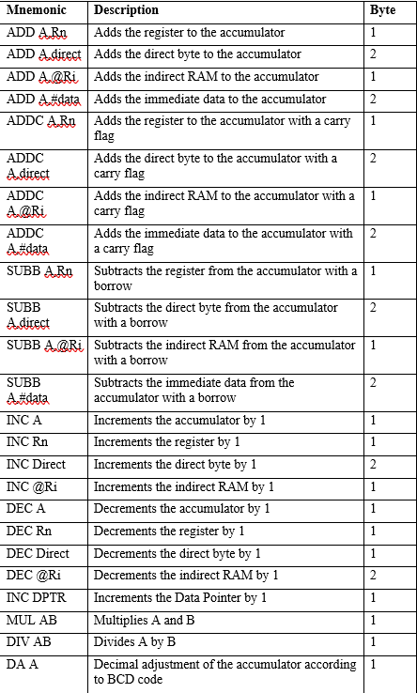
Arithmetic Instructions: Arithmetic instructions perform several basic operations such as addition, subtraction, division, multiplication etc. After execution, the result is stored in the first operand.
For eg: ADD A,R1
The result of addition (A+R1) will be stored in the accumulator.

Slide 30
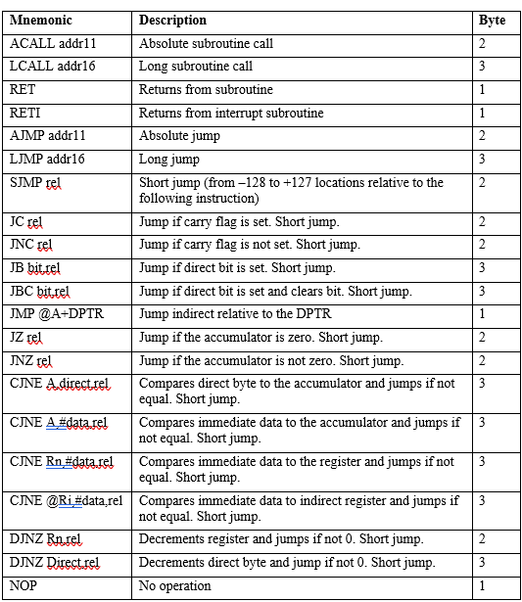
Branch Instructions: There are two kinds of branch instructions:
Unconditional jump instructions: upon their execution a jump to a new location from where the program continues execution is executed.
Conditional jump instructions: a jump to a new program location is executed only if a specified condition is met. Otherwise, the program normally proceeds with the next instruction.

Slide 31
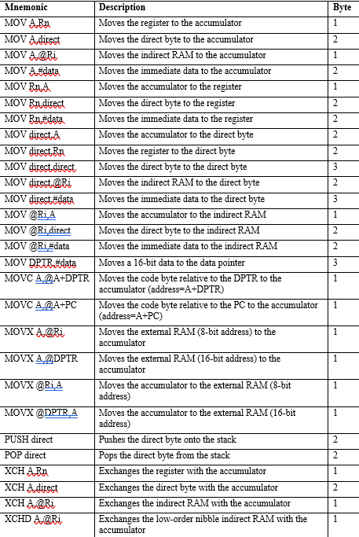
Data Transfer Instructions: They move the content of one register to another. The register the content of which is moved remains unchanged. If they have the suffix “X” (MOVX), the data is exchanged with external memory.

Slide 32
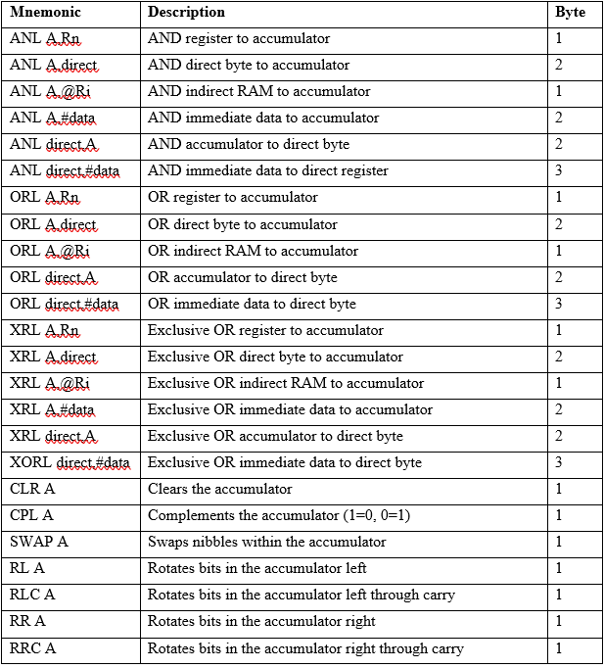
Logic Instructions : They perform logic operations upon corresponding bits of two registers. After execution, the result is stored in the first operand.

Slide 33
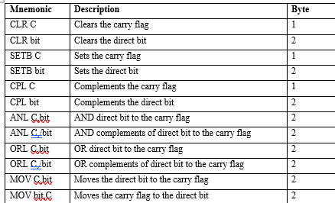
Bit-oriented Instructions: Similar to logic instructions, bit-oriented instructions perform logic operations. The difference is that these are performed upon single bits.

Slide 34
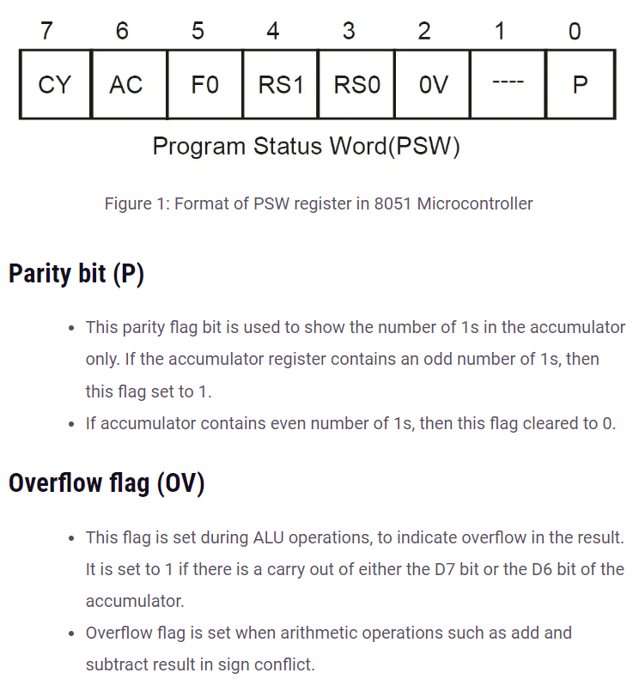

Slide 35
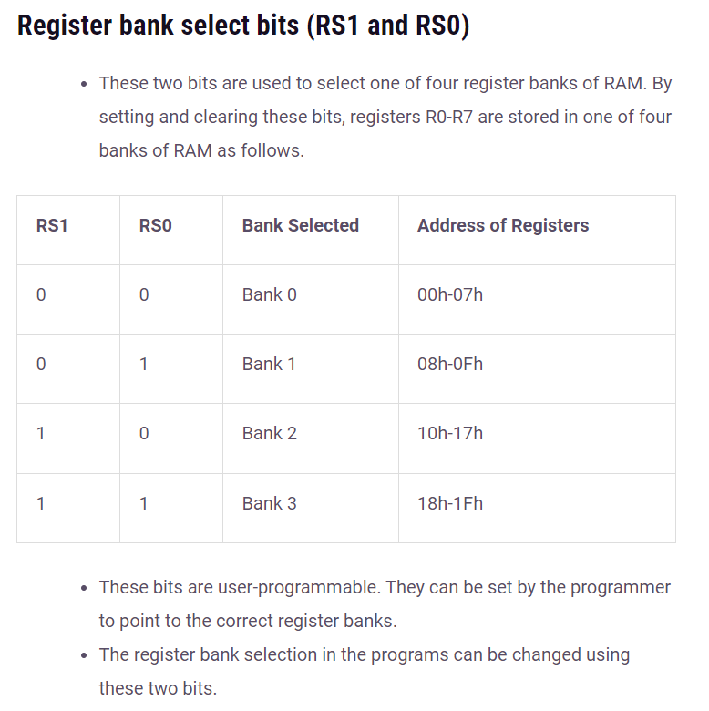

Slide 36
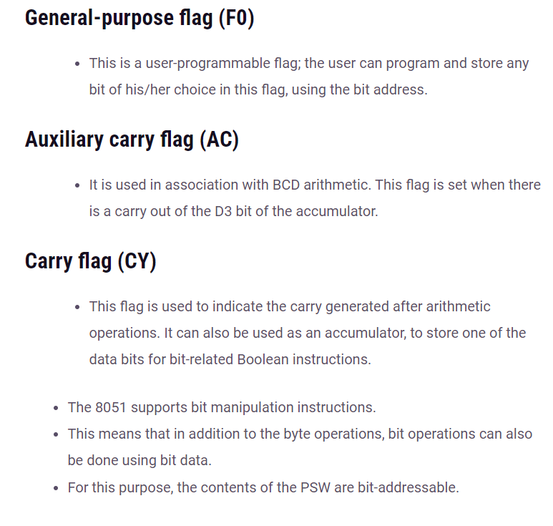

Slide 37
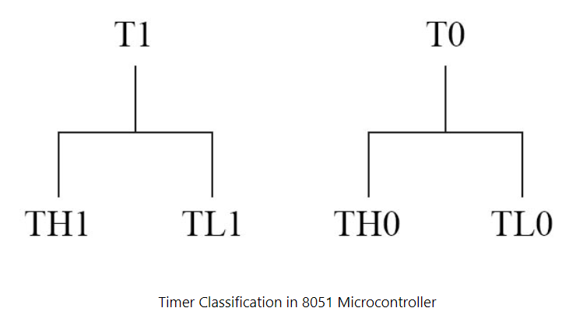
Timers of 8051
There are two timers in 8051, both are 16 bit timers . These are up counters. They can count from 0000 to FFFF ( 0 to 65,535 ). However, in each timer, one register is not enough to store 16bits, so both the timers have a total 4 SFRs, each SFR to store 8 bits. To trigger these timers they require a clock ( either external or internal depends on many parameters ).
As 8051 has 8-bit architecture, each of these 16 bit timers can be accessed by two separate 8-bit registers.
TMOD and TCON registers.

Slide 38
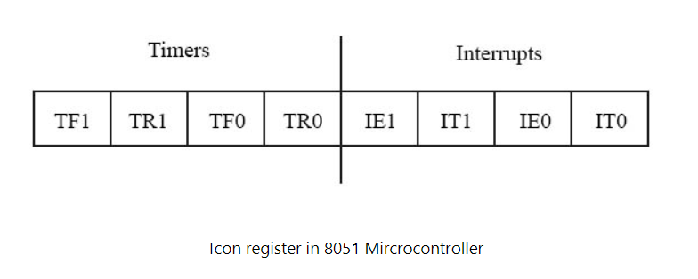
TCON register:
It is also bit addressable( each of 8 bits can be controlled individually ) . Out of 8 bits of Tcon , 4 bits are for timer and the other 4 bits are for INT0 and INT1 related purposes.

Slide 39
TCON flag bits | Description
TF1 | Timer overflow flag for timer 1. Whenever a timer overflow event occurs in timer 1, this flag becomes 1 and then interrupt is sent to the processor and as the processor goes to ISR this flag becomes zero.
TF0 | Timer overflow flag for timer 0. Whenever a timer overflow event occurs in timer 0, this flag becomes 1 and sends an interrupt to the processor and as the processor goes to ISR this flag becomes zero.
TR1 | Timer run for timer 1. Whenever the TR1 flag is 1, it means enabling the timer 1 ( enabling timer / counter depends on another flag of another SFR ).
TR0 | Timer run for timer 0. Whenever the TR0 flag is 1, it means enabling the timer 0 ( enabling timer / counter depends on another flag of another SFR ).
IE0 | This stands for interrupt external for INT0. whenever this flag is HIGH, it means an interrupt occurs at INT0.
IE1 | This stands for interrupt external for INT1. whenever this flag is HIGH, it means an interrupt occurs at INT1.
IT1 | IT1 stands for interrupt type for INT1. If IT1 = 0, then it is level triggering otherwise edge triggering. If IT0 = 0, then it is level triggering or else edge triggering.
IT1 | IT1 is for interrupt type for INT0.

Slide 40
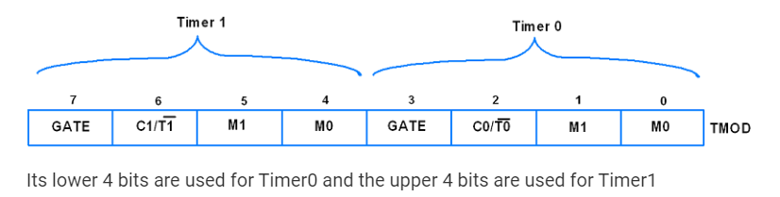
TMOD register:
TMOD is an 8-bit register used to set timer mode of timer0 and timer1.

Slide 41
TMOD flag bits | Description
GATE | 1 = Enable Timer/Counter only when the INT0/INT1 pin is high and TR0/TR1 is set. 0 = Enable Timer/Counter when TR0/TR1 is set.
C/T(Counter/Timer) | Timer or Counter select bit 1 = Use as Counter 0 = Use as Timer
M0/M1 | Timer/Counter mode select bit
To select modes:
M1 | M0 | Mode
0 | 0 | 0 (13-bit timer mode)
0 | 1 | 1 (16-bit timer mode)
1 | 0 | 2 (8-bit auto-reload mode)
1 | 1 | 3 (split timer mode)

Slide 42
Serial Ports of 8051
Serial transfer: In serial transfer, data is transfer to device located many meters away this method is used for long distance data transfer. Serial communication is mostly used for transmitting and receiving the signal. The 8051 microcontroller is consisting of Universal Asynchronous Receiver Transmitter (UART) used for serial communication. The signals are transmitted and received by the Rx and Tx pins of microcontroller.
Parallel transfer: In parallel transfer, data is transferred in 8 or more lines. In this wire conductor is used for transferring data to a device that is only a few feet away.

Slide 43
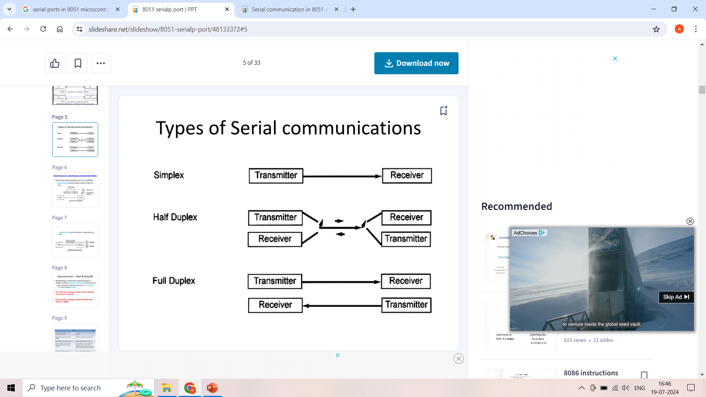
Modes of Serial transmission
There are two ways to transmit serial data: Simplex and Duplex.
In simplex transmissions, the computer can only send data. There is only one wire.
If the data can be transmitted and received, then it is a duplex transmission. Duplex transmissions can be half or full duplex depending on whether or not the data transfer can be simultaneous
If the communication is only one way at a time, it is half duplex.
If both sides can communicate at the same time, it is full duplex
Full duplex requires two wire conductors for the data lines (in addition to the signal ground)

Slide 44
Serial Communication can be : Asynchronous and Synchronous.
Synchronous Communication: Transfer a block of data (characters) at a time. The events are referenced to a clock. Example: SPI bus, I2C bus.
Asynchronous Communication: Transfer a single byte at a time. There is no clock. The bytes are separated by start and stop bits. Example: UART.
The rate of data transfer in serial data communication is state as bps (bits per second)/ baud rate.
IC’s for serial communication : UART (Universal asynchronous receiver- transmitter), USART (Universal synchronous-asynchronous receiver-transmitter).
8051 uses SBUF (serial buffer) register to hold data, SCON (serial port control) register to control data communication and PCON (power mode control) register to control data rates.

Slide 45
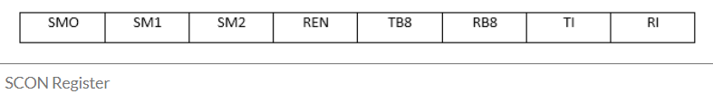
SCON register:
It is a bit addressable register used to set the mode in which serial communication takes place in the controller

Slide 46
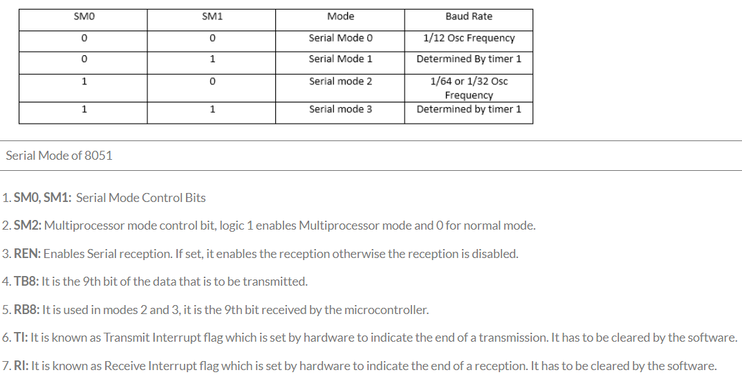

Slide 47
Interrupt
An interrupt is a signal to the processor emitted by hardware or software indicating an event that needs immediate attention.
Whenever an interrupt occurs, the controller completes the execution of the current instruction and starts the execution of an Interrupt Service Routine (ISR) or Interrupt Handler.
ISR tells the processor or controller what to do when the interrupt occurs. The interrupts can be either hardware interrupts or software interrupts.
Hardware Interrupt
A hardware interrupt is an electronic alerting signal sent to the processor from an external device, like a disk controller or an external peripheral.
For example, when we press a key on the keyboard or move the mouse, they trigger hardware interrupts which cause the processor to read the keystroke or mouse position.

Slide 48
Software Interrupt
A software interrupt is caused either by an exceptional condition or a special instruction in the instruction set which causes an interrupt when it is executed by the processor.
For example, if the processor's arithmetic logic unit runs a command to divide a number by zero, to cause a divide-by-zero exception, thus causing the computer to abandon the calculation or display an error message.
What is Polling?
The state of continuous monitoring is known as polling. The microcontroller keeps checking the status of other devices; and while doing so, it does no other operation and consumes all its processing time for monitoring. This problem can be addressed by using interrupts.
In the interrupt method, the controller responds only when an interruption occurs. Thus, the controller is not required to regularly monitor the status (flags, signals etc.) of interfaced and inbuilt devices.

Slide 49

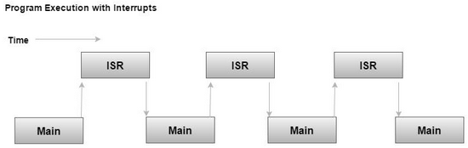
Interrupt Service Routine (ISR)
For every interrupt, there must be an interrupt service routine (ISR), or interrupt handler.
When an interrupt occurs, the microcontroller runs the interrupt service routine.
For every interrupt, there is a fixed location in memory that holds the address of its interrupt service routine, ISR.
The table of memory locations set aside to hold the addresses of ISRs is called as the Interrupt Vector Table.

Slide 50
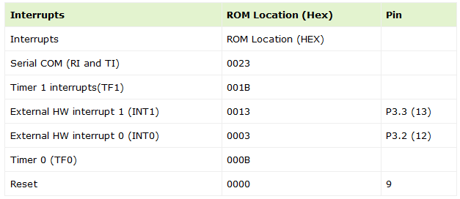
Interrupt Vector Table
There are six interrupts including RESET in 8051.

Slide 51
Steps to handle an Interrupts
There are six interrupts including RESET in 8051.
The microcontroller closes the currently executing instruction and saves the address of the next instruction (PC) on the stack.
It also saves the current status of all the interrupts internally (i.e., not on the stack).
It jumps to the memory location of the interrupt vector table that holds the address of the interrupts service routine.
The microcontroller gets the address of the ISR from the interrupt vector table and jumps to it. It starts to execute the interrupt service subroutine, which is RETI (return from interrupt).
Upon executing the RETI instruction, the microcontroller returns to the location where it was interrupted. First, it gets the program counter (PC) address from the stack by popping the top bytes of the stack into the PC. Then, it start to execute from that address.

Slide 52
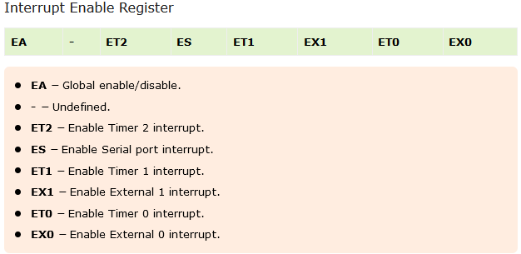
Enabling and Disabling the Interrupts
Upon Reset, all the interrupts are disabled even if they are activated. The interrupts must be enabled using software in order for the microcontroller to respond to those interrupts.
IE (interrupt enable) register is responsible for enabling and disabling the interrupt. IE is a bitaddressable register.

Slide 53
Enabling and Disabling the Interrupts
To enable an interrupt, we take the following steps −
Bit D7 of the IE register (EA) must be high to allow the rest of register to take effect.
If EA = 1, interrupts will be enabled and will be responded to, if their corresponding bits in IE are high.
If EA = 0, no interrupts will respond, even if their associated pins in the IE register are high.

Slide 54
List of Arithmetic instructions of 8051:
In 8051 Microcontroller there are 24 different instructions under the Arithmetic Group.
In total there are 64 opcodes.
The Carry Flag (CY), Auxiliary Carry (AC)and Overflow flag (OV) are affected based on the result of ADD, ADDC, SUBB etc. instructions.
ADD- Addition without carry
ADDC- ADDC stands for addition with carry
SUB- Subtraction
SUBB- Subtraction with Borrow
MUL-Multiplication
DIV-Division

Slide 55
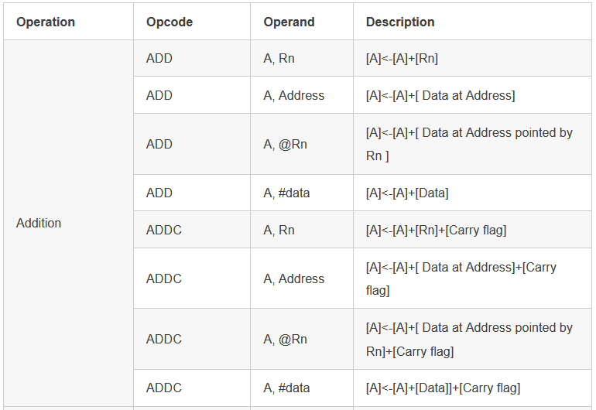
Arithmetic instruction: Addition

Slide 56
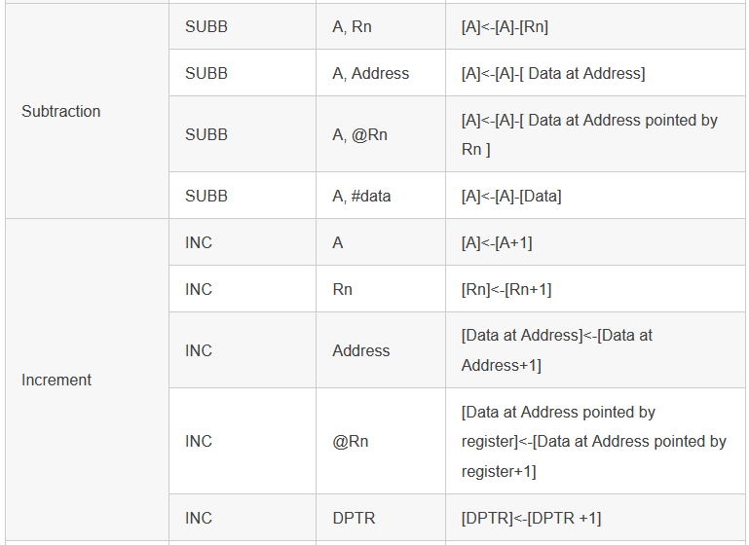
Arithmetic instruction: Subtraction and Increment

Slide 57
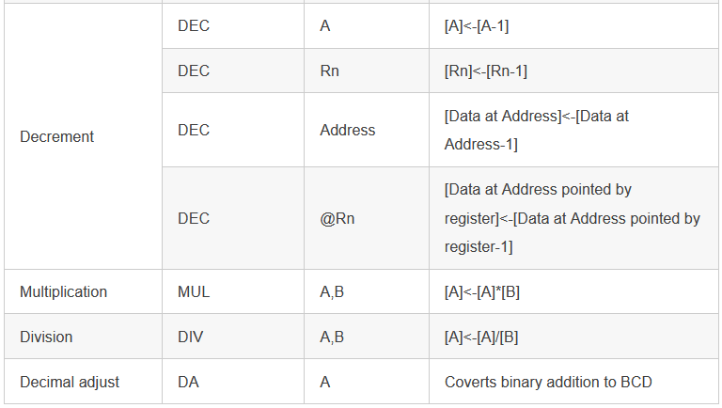
Arithmetic instruction: Decrement, Multiplication, Division, and Decimal Adjust

Slide 58
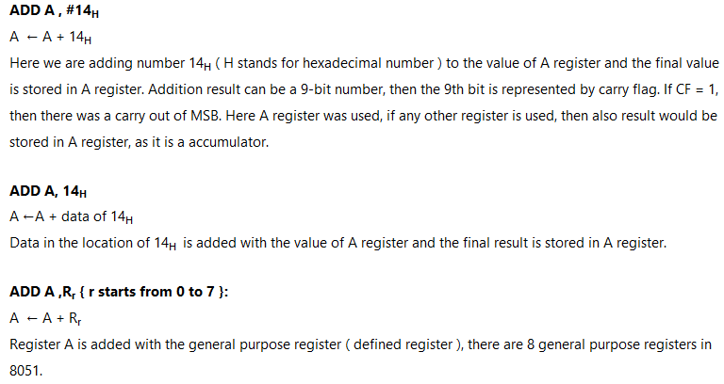
Arithmetic instruction: Few Examples

Slide 59
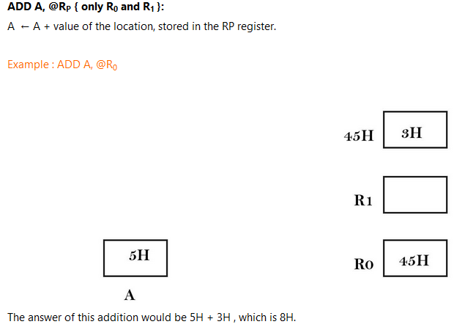
Arithmetic instruction: Few Examples

Slide 60
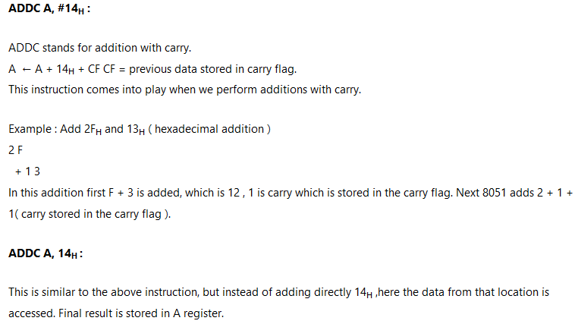
Arithmetic instruction: Few Examples

Slide 61
List of Logical instructions of 8051:
In 8051 Microcontroller there are 25 logical instructions in 8051. AND , OR, XOR , NOT …. These instructions come under logical instructions.
In total there are 49 opcodes.
The Carry Flag (CY) affects only by instruction RRC and RLC.
ANL- AND Operation
ORL-OR operation
XRL- XOR Operation
CLR-Clear
CPL-Complement
RL/RLC- Rotate Left
RR/RRC- Rotate Right
SWAP-Swap

Slide 62
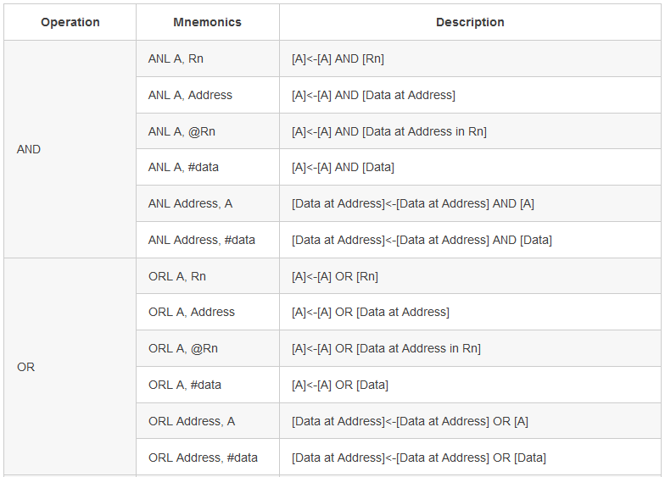
Logical instruction: AND & OR

Slide 63
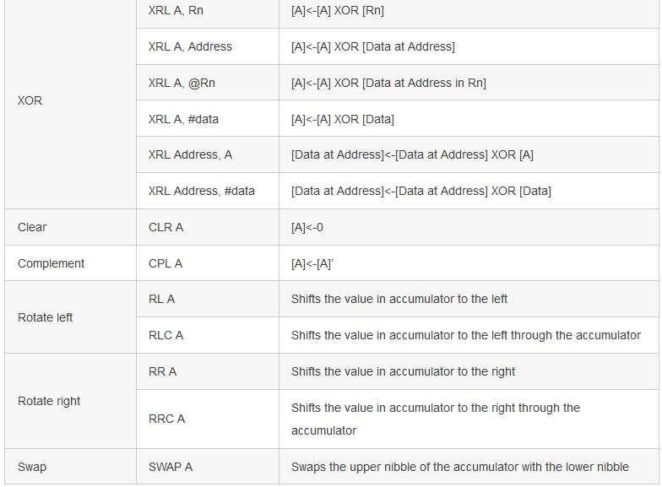
Logical instruction: XOR, Clear, Complement, Rotate Left and right, and Swap

Slide 64
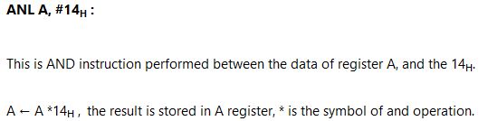
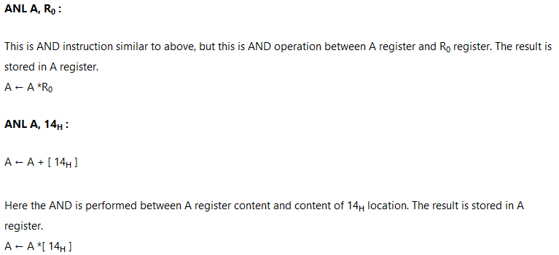
Logical Instruction: Few Examples

Slide 65
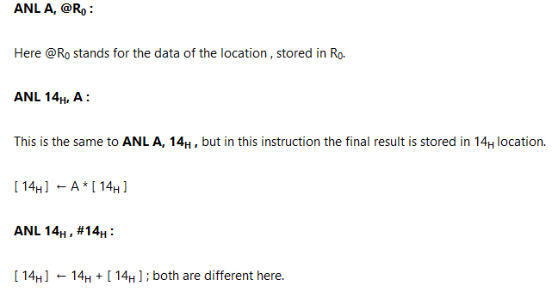
Logical Instruction: Few Examples

Slide 66
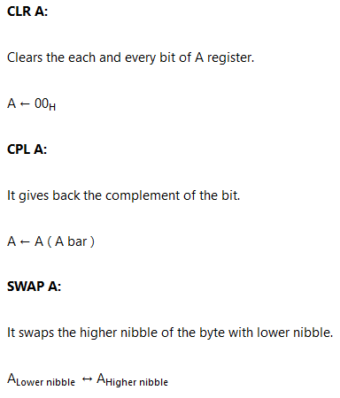
Logical Instruction: Few Examples

Slide 67
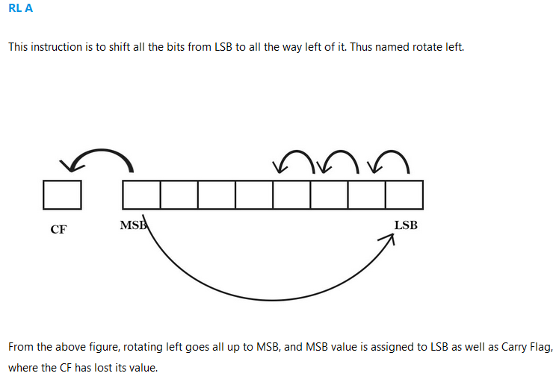
Logical Instruction: Few Examples

Slide 68
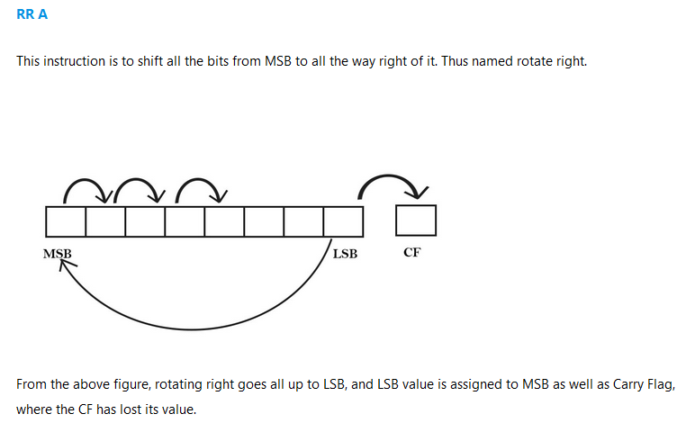
Logical Instruction: Few Examples

Slide 69
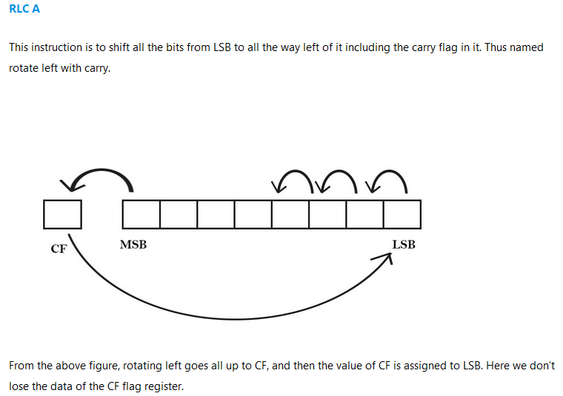
Logical Instruction: Few Examples

Slide 70
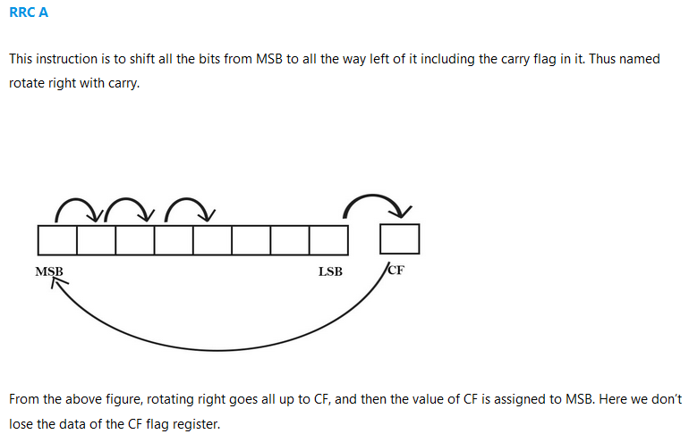
Logical Instruction: Few Examples

Slide 71
Thank you

